Slide 1
Introduction to Data Science
Section 6 – Basic Bayes

Slide 2
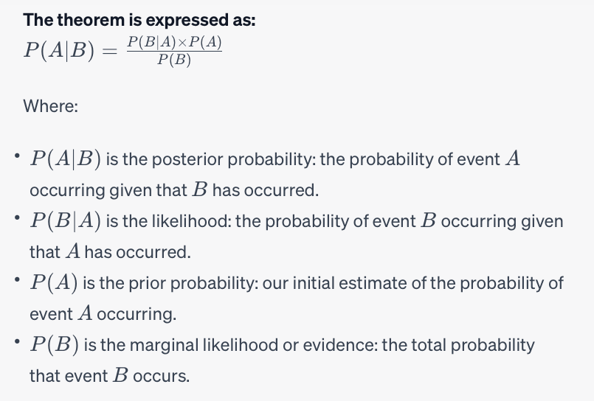
Bayes Theorem
It provides a way to find the probability of an event A occurring given ("conditioned on") the probability of another related event B.

Slide 3
Simple example (english)
Imagine you're testing for a rare disease which affects 1% of the population.
You have a test that
correctly identifies the disease 99% of the time (true positive)
incorrectly says a healthy person has the disease 2% of the time (false positive).
Now, you take the test and test positive. What is the probability you actually have the disease?
Solution: Use Bayes' theorem.
A is the event that you have the disease. B is the event that you test positive.

Slide 4
Simple example (math-lish)
Reformulate with math. Let
A be the event of having the rare disease,
B be the event of testing positive.
Imagine you're testing for a rare disease which affects P(A) = 1% of the population.
You have a test that
correctly identifies the disease P(B|A) = 99% of the time (true positive)
incorrectly says a healthy person has the disease P(B|not A) = 2% of the time (false positive).
Now, you take the test and test positive. What is the probability P(A|B) you actually have the disease?

Slide 5
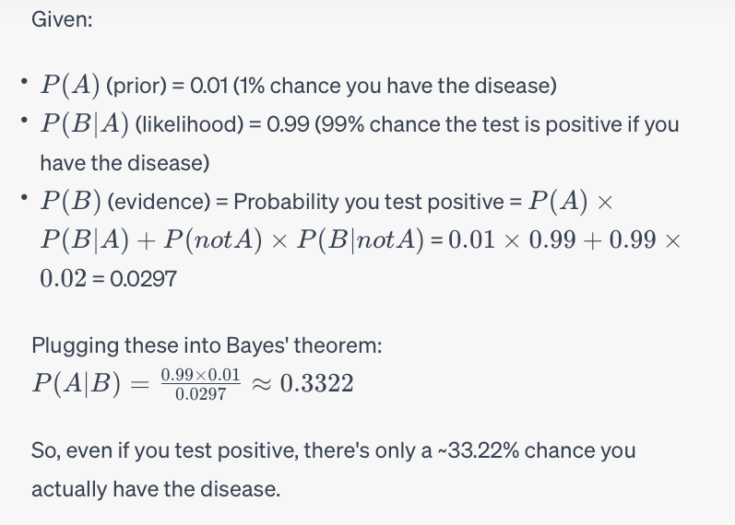
Simple example (math)

Slide 6
Frequentist vs Bayesian
One goal of Statistics: use data to infer parameters of a model
e.g., linear regression models data linearly and has parameters β.
Traditional (frequentist) statistics
usually focuses on making point estimates of parameters based on observed data.
e.g., frequentist linear regression, β is some concrete numbers that best fit the data.
Bayesian statistics
treats parameters as random variables.
compute a (posterior) distribution over possible parameter values given the data.

Slide 7
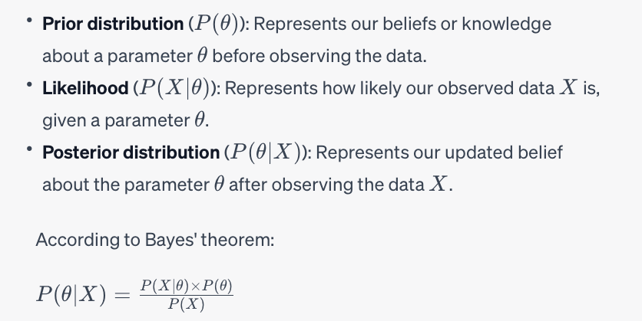
Bayesian Inference Formula

Slide 8
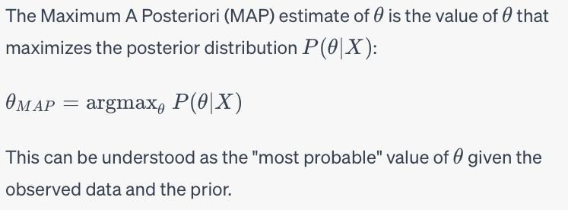
MAP Estimation
Another term for MAP estimate is taking the mode of the posterior distribution.

